Slide 1
ITk ASICs Register Converters
Greta Goldberg, Albrun Johnson
ITk Strips System Test & DAQ Meeting

Slide 2
Overview
Converts between output signal and readout information for each register
Can input binary, hexadecimal, or decimal signal
Update: can now select registers by name, and hexadecimal number in addition to decimal number
Update of register order and configuration
Old version: http://www.hep.upenn.edu/ATLAS_upgrade/ITk/ASICs/Registers.html

Slide 3
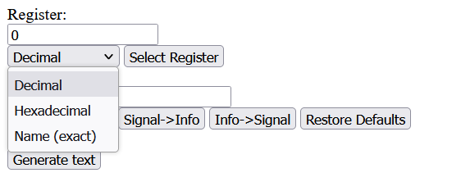
Registers
Figure 1: Register Selection

Slide 4
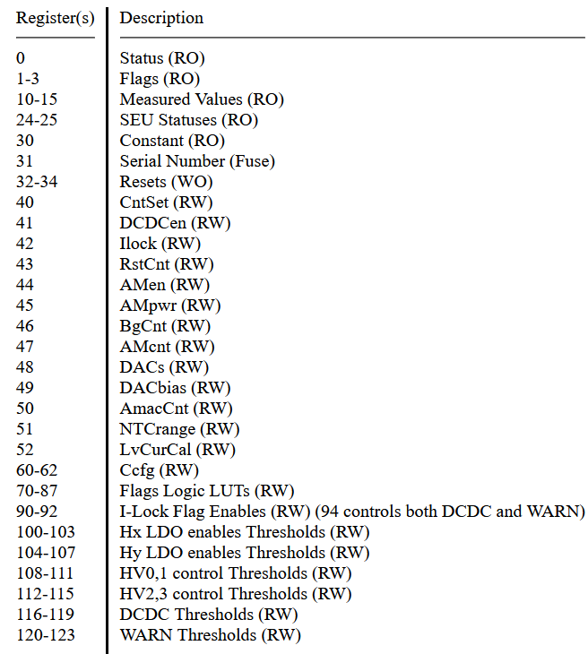
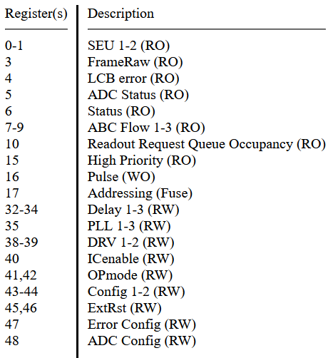
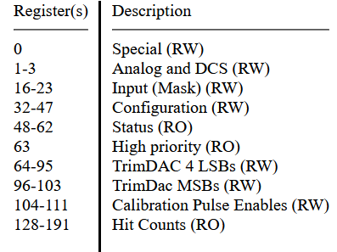
Registers cont.
Figure 2: ABCStar Register Descriptions
Figure 3: HCCStar Register Descriptions
Figure 4: AMACStar Register Descriptions

Slide 5
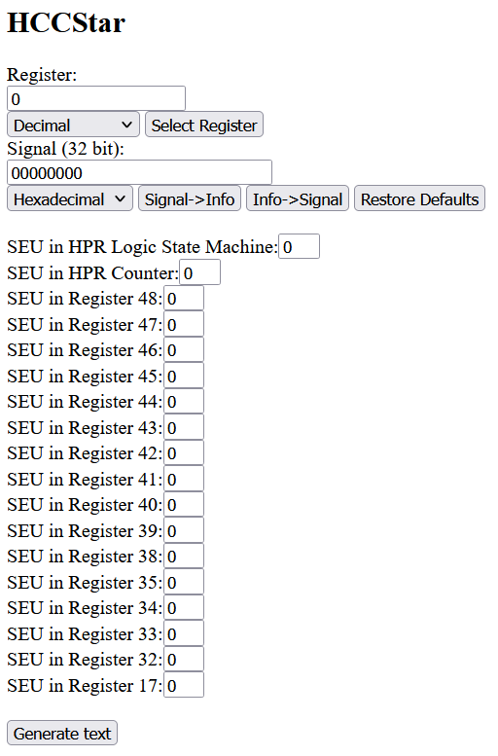
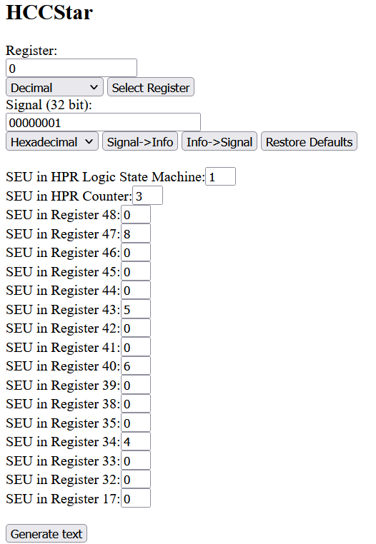
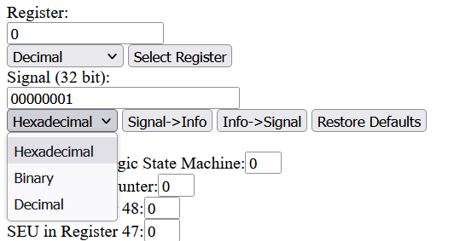
Conversion with Example 1
Figure 7: Signal Base Number Options
Figure 5: Signal to Info Conversion for HCCStar Register 0
Figure 6: Info to Signal Conversion for HCCStar Register 0

Slide 6
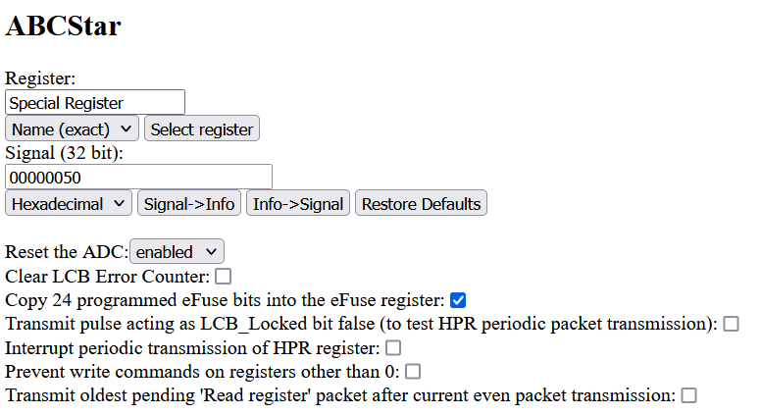
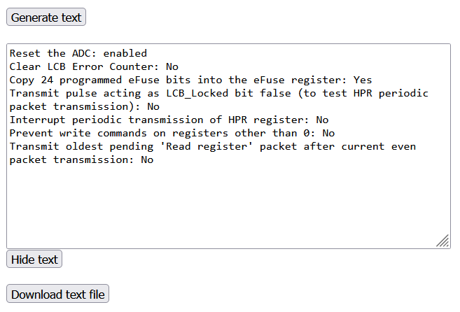
Conversion with Example 2
Figure 8: Info to Signal Conversion for ABCStar Register 0
Figure 9: Corresponding Text Output

Slide 7
References
https://gitlab.cern.ch/atlas-itkstrasic-group/abcstar/-/blob/master/abcstar/trunk/doc/ABCSTARV1_latex/ABCSTARV1_latex.pdf
https://gitlab.cern.ch/atlas-itkstrasic-group/hccstar/-/blob/hccstarv1-doc/doc/HCCStar_Spec.pdf
https://gitlab.cern.ch/atlas-itkstrasic-group/AMAC/-/blob/star_doc/doc/Specification/AMACStar_Spec.pdf

